Slide 1
DISTRICT ASSEMBLY
JUNE 18 | DUBLIN, GEORIGA
District 6920 Youth Services

Slide 2
District 6920 | Youth Services Team
Resources Available
2022 - 2023
District Youth Services Director: Donald Fountain
RYE Chair: Mike Muldowney
RYLA Chair:
Preston Johnson HS Speech Competition Chair: Ford Bowen
Laws of Life Chair:
Interact Chair: Jan Horadan
EarlyAct Chair: Sara Barron
Rotaract Chair: Tajae Francis District Rotaract Representative: Pryce May
Youth Protection Officer: Steve Lynn
Rotary International Website
www.rotary.org
Rotary District 6920 Website
www.rotarydistrict6920.org
Rotary Zones 33-34
www.rizones33-34.org
Interact Facebook www.facebook.com/interactofficial
Rotaract Facebook www.facebook.com/rotaract
Rotary Youth Exchange Southeast
www.ryese.org

Slide 3
What is Interact?
Rotary Sponsored Club
Young people ages 12 – 18
Develop leadership skills
Service Above Self
One local project and one international
Sponsored by their local Rotary Club as mentor and guides

Slide 4
Basic Steps To Start An Interact Club
Identify a “Membership Base” (Community or School Based)
Hold Informational Meeting
Hold at least (2) Organizational Meetings
Elect / Appoint Executive Member & Instill Structure (Sustainability)
Establish strong relationship with sponsoring Rotary Club
Charter Club (Adopt standard club constitution, By Laws)
Complete RI organizational form)
Plan an Inaugural ceremony
Report / Update RI Database
https://my.rotary.org/en/report-your-interact-club-advisor

Slide 5
Rotary Sponsored Club
Total Active Interact Clubs as of April 20, 2022 = 24
New Interact Clubs during 2021 - 2022 = 2
Aquinas High School - Chartered 03/18/2022
Sponsoring Rotary Club – Augusta
Jenkins County High School - Chartered 03/31/2022
Sponsoring Rotary Club – Millen
Potential new Interact Club for 2022-2023
Jones County Rotary Club
Milledgeville Rotary Club

Slide 6
Rotary Sponsored Club
MAIN OBJECTIVES PRIOR TO JUNE 30, 2022
Sponsoring Rotary Club make contact with your Interact Club and Club Advisor
Update Interact Information in My Rotary
Required prior to June 30 each year
Club could be terminated if not updated in two (2) years

Slide 7
What is Rotaract?
Rotary Club Partner
Open to young adults at least 18 years old
College or Community Based
Take action locally and internationally
Connect with a global community of Rotarians and Rotaractors
HAVE FUN

Slide 8
Rotary Club Partner
Rotaract Club:
Augusta Tech
Organized on July 27, 2021, Chartered on Sept. 28, 2021
Augusta University
College of Coastal Georgia
Georgia Southern – Armstrong
Middle Georgia State
Oconee Fall Line – South Campus
Statesboro
Valdosta State
Vidalia
Sponsoring Club(s):
Augusta
Augusta
Brunswick, Golden Isles, St. Simons Island
Savannah South
Warner Robins
Dublin
Downtown Statesboro
Valdosta
Vidalia

Slide 9
Rotary Club Partner
MAIN OBJECTIVES PRIOR TO JUNE 30, 2022
Sponsoring Rotary Club or Rotaract Club contact your Rotaract Club Advisor or Officers
Update Rotaract Information in My Rotary (Clubs must list all members of their Rotaract Club)
Rotaractors will pay dues starting July 1, 2022
$8 Community Based & $5 School Based
$50 one time fee for newly Chartered Rotaract Club eliminated
Clubs can set upper Age Limits
Clubs can participate in Global Grants
Will be represented on committees on all levels of Rotary and will have an advisory seat at RI Board Meeting

Slide 10
ELEVATE ROTARACT
Rotary Club Partner
Increase Number of Rotaractors reported to Rotary by 100%
Increase Rotaractors who join by 20%
Increase the number of Rotaractors to 1 million
by 2029

Slide 11
What is EarlyAct?
Rotary Sponsored Club
EarlyAct is a school-wide service club for elementary students from grades Kindergarten- 5th It is sponsored by one of the local Rotary clubs in the area in which the school is located.
The mission of EarlyAct is to promote GOODWILL, UNDERSTANDING and PEACE through the active participation of its student members so that with committed citizenship and effective leadership they may improve the quality of life of their school, local and global
communities. Through EarlyAct, students learn to take responsibility for real-life problems and to realize the significant impact of their involvement.

Slide 12
Guidelines of EarlyAct
Rotary Sponsored Club
Three Service Projects Annually- One for the school, one for the community, one global project (furthers international understanding)
EarlyAct Club meets twice per month for thirty minutes
Officers of EarlyAct are selected from the 2 senior classes of the elementary school
There are no dues

Slide 13
Rotary Sponsored Club
Is YOUR Rotary Club ready to sponsor an EarlyAct club?
•Begin by appointing an EarlyAct subcommittee
•One committee member can act as the Rotarian advisor to the EarlyAct Club
•Make a presentation to your Rotary Club
•The EarlyAct subcommittee can contact the appropriate school official or principal

Slide 14
RYLA
RYLA brings together individuals from different cultures,
educational levels, and work experience with noted
community professionals to interact, learn, and discuss
strategies for dealing with future challenges and opportunities.
Open to rising high school Juniors and Seniors
Candidates should hold a position of leadership or be interested in expanding and displaying leadership qualities.
Candidates can be a relative of a Rotarian, foreign exchange student, or past recipient
Will be held June 9-11, 2023 at College of Coastal Georgia in Brunswick, GA.

Slide 15
District 6920 Speech Contest
Initiated in 1997 by Dublin Rotarian & Past District Governor Preston Johnson
Engages Rotarians, Educators and Students
Personal development of our community & nation’s future leaders.
Requires students to research and learn about the good works of Rotary locally and globally.

Slide 16
Speech Contest Guidelines
Schedule Club Speech Contest
Notify High School in Area
Freshman through Seniors may compete
Speech base on RI President’s Theme or “Rotary 4-Way Test.”
Speech limited to 3 to 4 minutes
Two finalists from each Club allowed to compete at zone – Cost $100 each, paid by club.
Three Zones – Winner of each zone receives $1,000. Must give speech at District Conference.

Slide 17
Outreach program of the Rotary Districts Character Education Program, Inc. (GRDCEP), a 501 (3) nonprofit organization whose vision is to transform lives by engaging students to reflect upon their lives, express personal beliefs and affirm strong character values through writing.

Slide 18
Teachers
Engage Your Class with Laws of Life
Benefits of Participating
Let students practice critical writing skills while reflecting on important life issues
Help students develop empathy, compassion and self-confidence
Help reduce the academic achievement gap
Create a forum where student of varying academic abilities can shine
Create a positive school climate
Meet key curriculum requirements
Encourage colleagues to run the Georgia Laws of Life Essay Contest

Slide 19
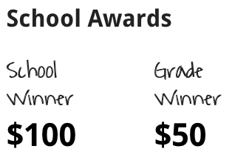
Students
Students Writing Tips & Awards
By writing an essay, you not only learn about yourself, but about the world around you. The contest gives you the chance to win cash prizes, while expressing your beliefs and values.
One $100 school winner per school. Three $50 grade level winners, for each school that meets the minimum participation requirements. To participate in the Georgia Laws of Life Essay Contest, a student must attend a high school that is registered with the contest for the current school year. If your school is not registered, you may encourage it to do so by sharing this website with your English teacher. All essays must be submitted through schools. Individual submissions cannot be accepted.

Slide 20
Rotary
Rotary & Character Education
Georgia Rotary Clubs
Rotary clubs operate the contest through the nonprofit Georgia Rotary Districts Character Education Program, Inc. Clubs support the Laws of Life contest financially and recognize winning students at local and district-wide meetings and conferences. Rotary clubs also supply volunteers who read and judge essays, who serve on the contest’s Board of Directors, and who volunteer their professional expertise to help build character and ethical literacy in our younger generation.

Slide 21
Objective: Instilling International understanding & goodwill creating positive change by empowering youth, making lasting connections.
Long-term exchanges last a full academic year, and student attend local schools and live with multiple host families.
Short-term exchanges last from several days to three months and are often structured as camps, tours, or homestays that take place when school is not in session.
Room and board are provided, as well as any school fees. Each program varies, but students are usually responsible for:
Round-trip airfare
Travel insurance
Travel documents (such as passports and visas)
Spending money and additional travel or tours
Rotary Youth Exchange builds peace
one young person at a time.

Slide 22
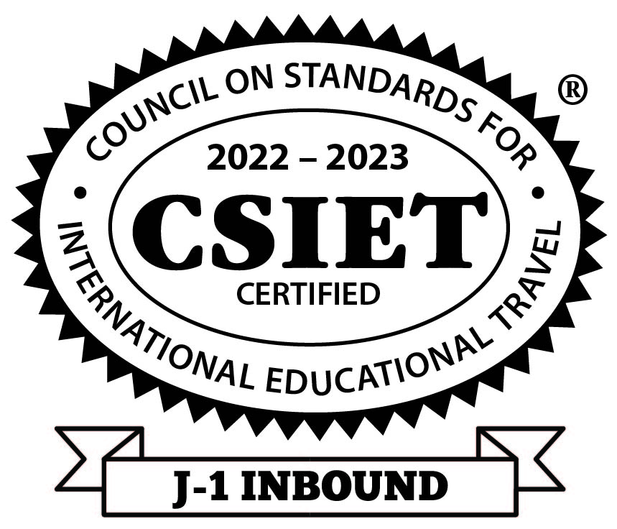
2022-2023 RYE GOALS
Introduce this wonderful life changing program for the youth in our communities to all the clubs in District 6920
1
Obtain commitment from 4 to 6 clubs in District 6920 to sponsor Youth Exchange in their club
2
Have 4 to 6 high school students qualify for the program and going abroad to study
3
Host 4 to 6 Inbound students to become part of our Rotary Family
4
Gain the experience in our District and Clubs to expand the program for future years
5
Key Links
Rotary International Youth Exchange www.rotary.org/en/our-programs/youth-exchanges
RYE Southeast ryese.org
CSIET www.csiet.org

Slide 23
Key Dates
August 1, 2022 Open application process
October 31, 2022 Application Deadline
November 2022 Interviews with potential student candidates and families conducted
December 15, 2022 Candidates selection finalized
January 2023 Student and family Orientation part 1
January – June 2023 Students study languages, learn about Rotary, participate in service projects
February – July 2023 Host Families for Inbound students selected and trained
June 2023 Student and Family Orientation part 2
Successful candidates get ready for departure
August 2023 Students depart for their new life with a new family
August 2023 Inbound students arrive and attend Orientation

Slide 24
Youth Protection Officer
Serve to foster safe operations across all youth programs.
Monitor national and local laws in relation to youth protection
Keep policies and procedures up to date
Ensure proper training is provided
Oversee the proper handling of all allegations related to youth services.

Slide 25
RYLA
District 6920
Imagine the Possibilities…
“Together, we see a world where people unite and take action to create lasting change…
Across the globe, in our communities, and in ourselves.”
Speech Contest
ROTARY YOUTH
EXCHANGE
Growing Rotary Membership

