Slide 1
Global Grants Management Training
Hamsa Thota, Ph.D.
DG 2017-18, DRFC 2020-23
June 18, 2022

Slide 2
RID 6920 History of Foundation Giving 1985-2022
Total Foundation Giving $ 10,187,551.06
10-year Total Giving $ 2,753,392.16
Annual Fund $ 7,941,966.16
Polio Plus $ 1,561,232.46
Endowment $ 343,426.13
Other $ 340,926.90

Slide 3
RID 6920 Stewardship of Funds Received
2012-22 Total DDF received $1.515 million
Our Allocation of DDF
Global Grant projects $725,000
District Grant projects $702,060
Polio Plus $115,000

Slide 4
RID 6920: Global Impact
2014-2022
Total No. of Global Grant projects 41
Total project budgets $ 3,615,872
Total Club giving $ 197,392
10 Countries
Brazil, Guatemala, Haiti, India, Panama, Puerto Rico, Sri Lanka, Turkey, Uganda, Zanzibar

Slide 5
RID 6920 Global Impact Illustration
Promote Peace and Mediate Conflict
End Polio Now,
COVID-19 Vaccination
Clean Water, Sanitation & Hygiene
Gil Tharp Rotary Scholarship Awarded to James Ferencsik, Savannah, 2017-18
2021-22 Cadet John Gordon, West Point Cadet, from Augusta
Polio: Gates Foundation match 2:1
*Support Community Vaccination in your area Clubs
Happy Schools – IndiaClean drinking Water-Zanzibar, Haiti, Uganda, Ghana
Notes:
John Gordon is the candidate

Slide 6
Examples of CHANGING LIVES with our service projects
Saving Lives in Georgia -
Mothers and Children
Basic Education and Literacy
Grow local economies
Guatemala Mayan/Panama Midwives Training
Saving Lives with Medicine – 7 clinics
$ 1 million global grant projects in boys and girls’ schools in India
School desks, toilets, basic hygiene and sanitation education
Sewing machines to empower women in India
Puerto Rico Sustainable Agriculture

Slide 7
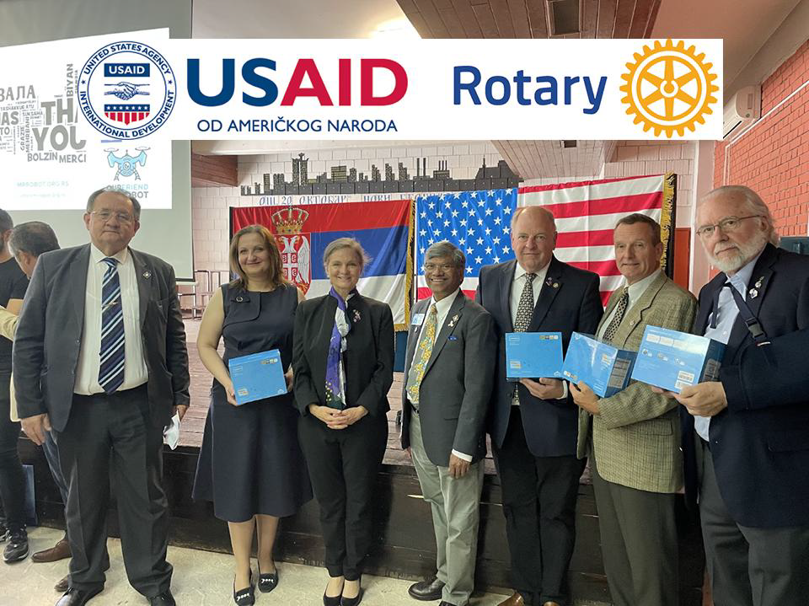
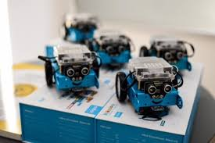
Danilo Ljevnaić
District Governor
District 2483
4. HEARTS OF EUROPE GLOBAL GRANT 2119523
“Rotary District 2483 for 100 schools“
Project: “Rotary District 2483 for 100 schools“
Type of grant: Humanitarian project
Area of focus: Basic education and literacy
Host club: Rotary Club Senta, District 2483
International sponsor Club: RC Savannah, D6920 USA
Beneficiary: Elementary schools (100 schools)
Type of donation: mBot robots
Budget: $76,185.00

Slide 8
Zorica Jestrović
Governor 2021/22
District 2483
HEARST OF EUROPE GLOBAL GRANT
“ROTARY DISTRICT 2483 FOR 100 SCHOOLS “-GG2234563
Continuation of the mBot robot project
Areal of focus: Basic education and literacy
Host Club: RC Beograd Čukarica
International Sponsor Club: RC St. Simons Island D6920
Type of donation: 500 mBot robots for 100 elementary schools
Beneficiary: 100 elementary schools in Serbia
Value of project: $77,400
Delivery of donation planned for: Sept/Oct.2022
Person in charge: PDG Vladimir Matić
Project coordinators:Srđan Pavličić, RC Beograd Čukarica

Slide 9
Fitzgerald Rotary Club

Slide 10
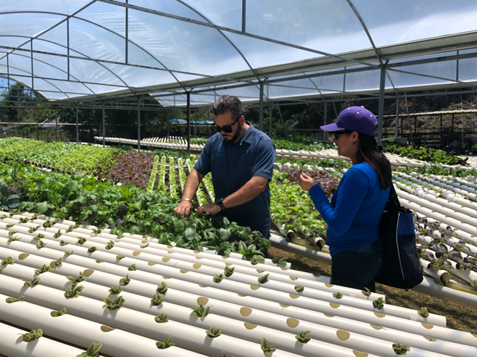
2019 Puerto Rico-Budget $289,100 Best in Class Implementation

Slide 11
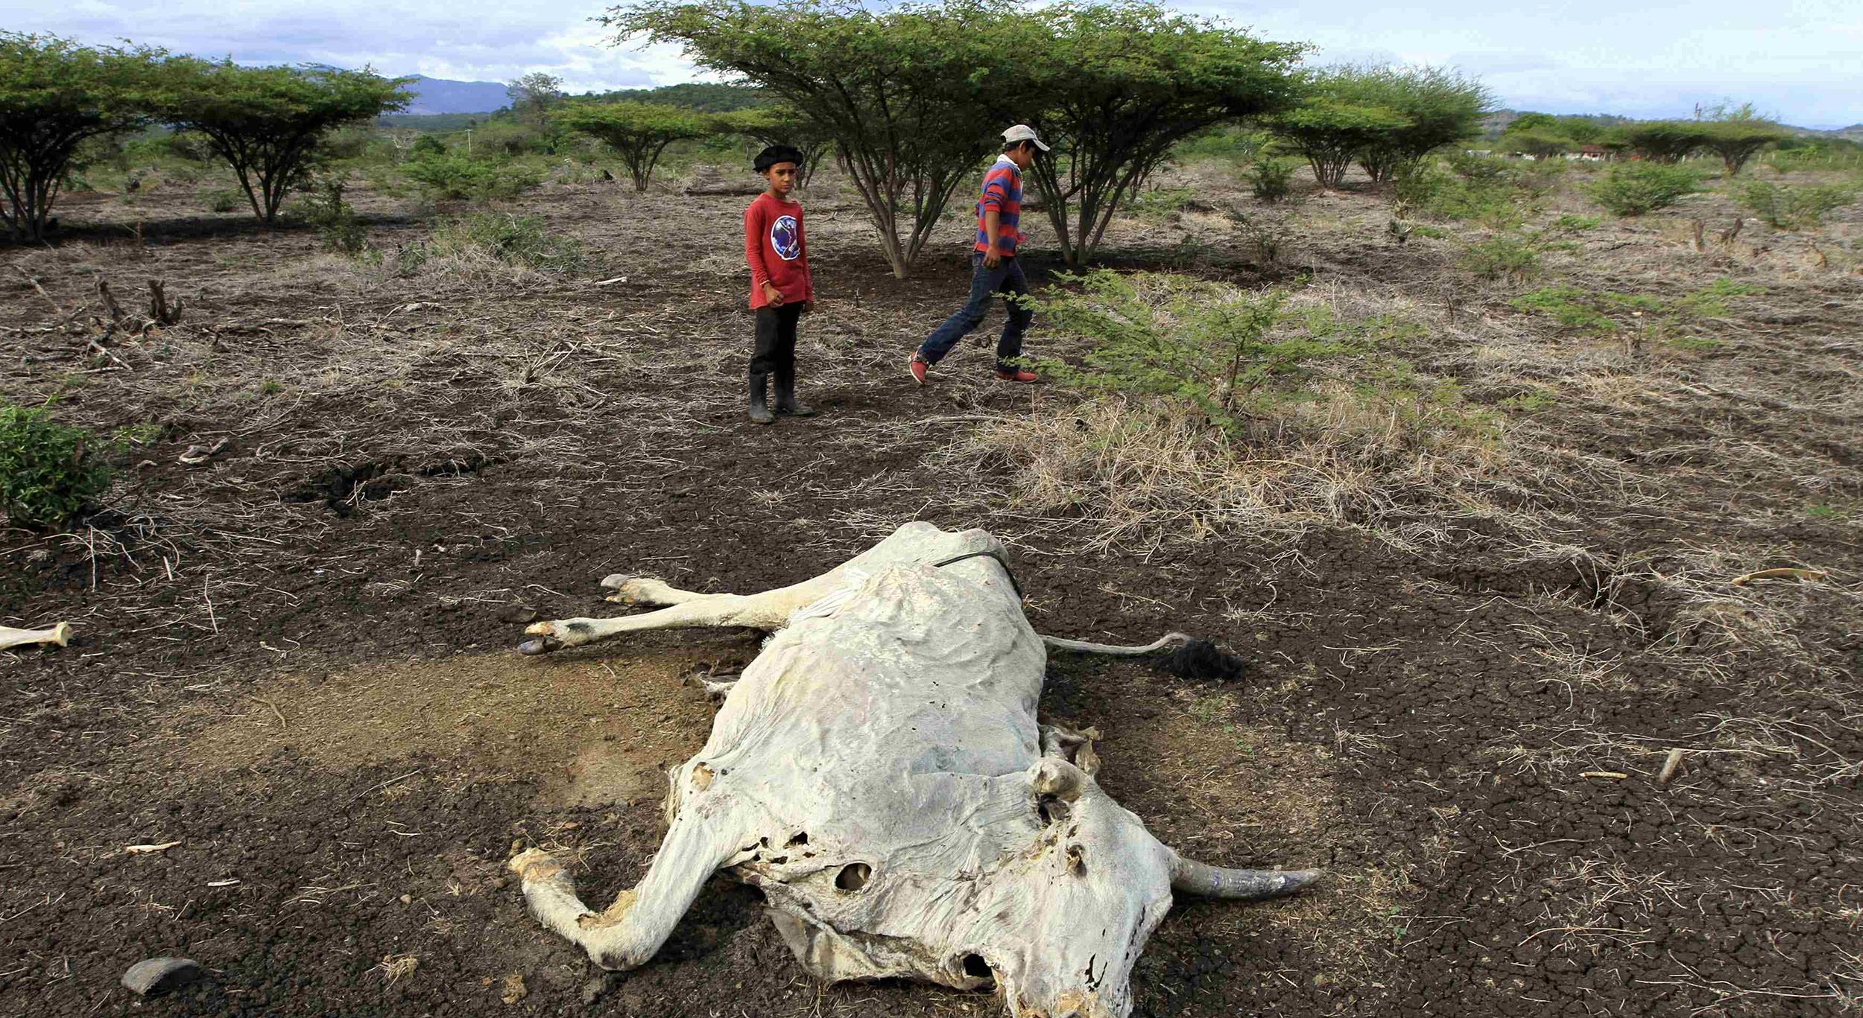
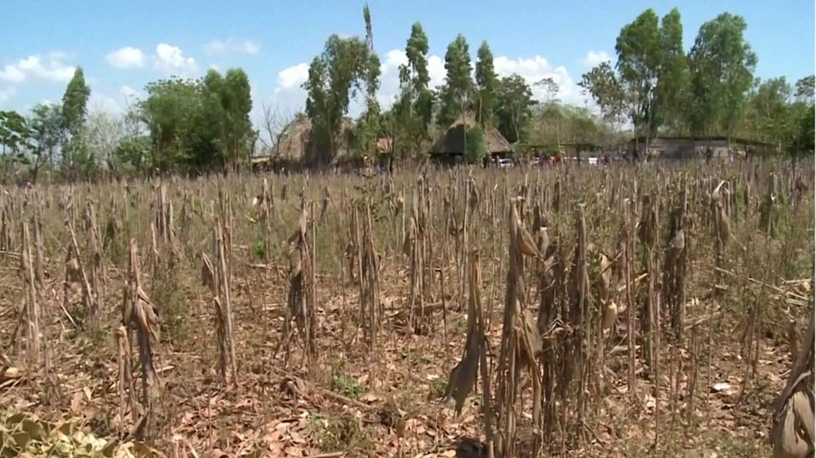
WHO LIVES IN THE DRY CORRIDOR
2021 GG2010395-Guatemala Hydroponics
67% of farmers are producers of basic grains (USAID, and the Food and Agriculture Organization of the United Nations (FAO)
These families are subsistence farmers (harvest and eat the food that they grow )
Net yearly income of farmers is Q5,400 ($716) to pay for basic needs for his family
1 in 3 families lacks sufficient food to meet their daily needs and more than three-quarters have no food reserves.
Up to 82 percent of the families have sold their farming tools and animals to purchase food. They often skip meals or eat less nutritious

Slide 12
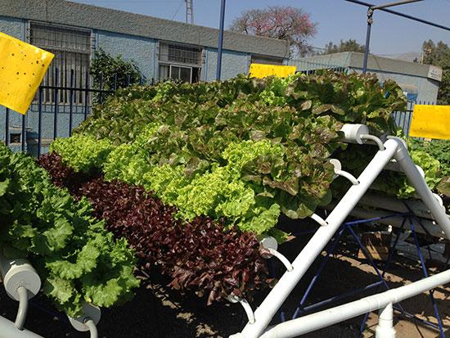
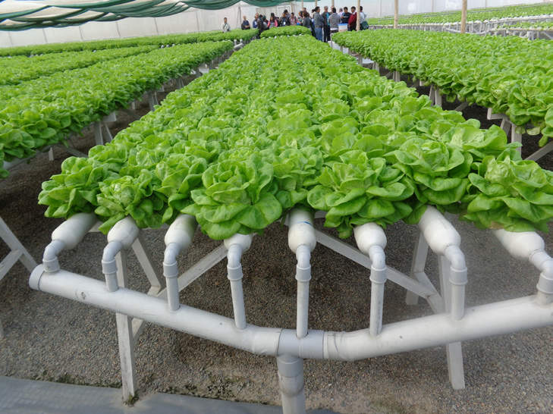
GG2010395-Guatemala Hydroponics
Method to be use in Guatemala- NFT hydroponics
Method of soil-less cultivation where plant roots are suspended above a stream of continuously flowing nutrient solution

Slide 13
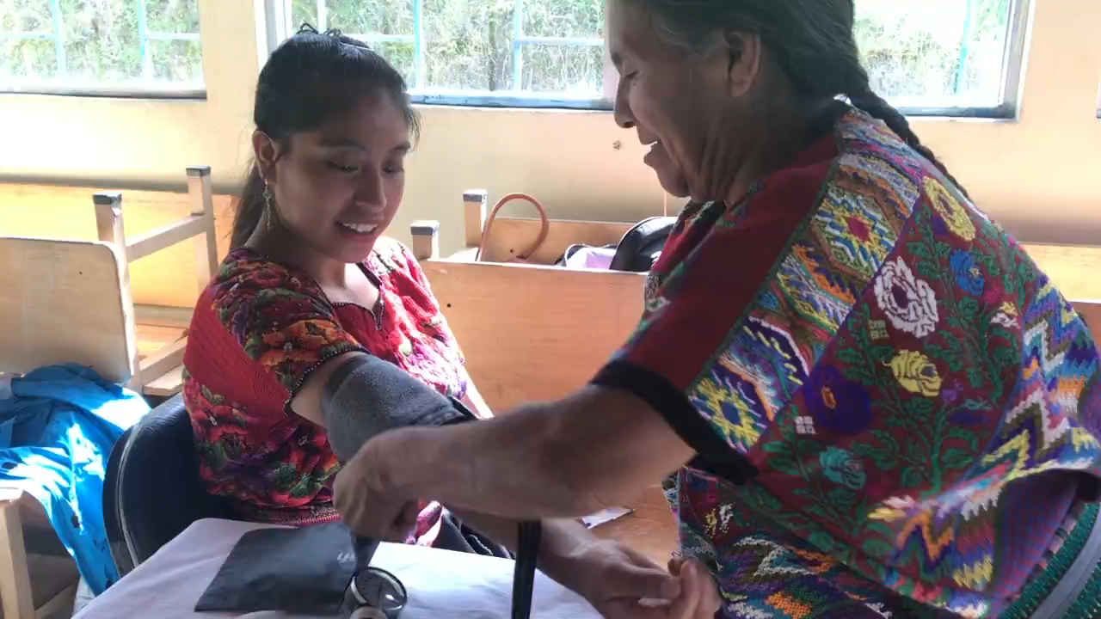
GUATEMALA

Slide 14
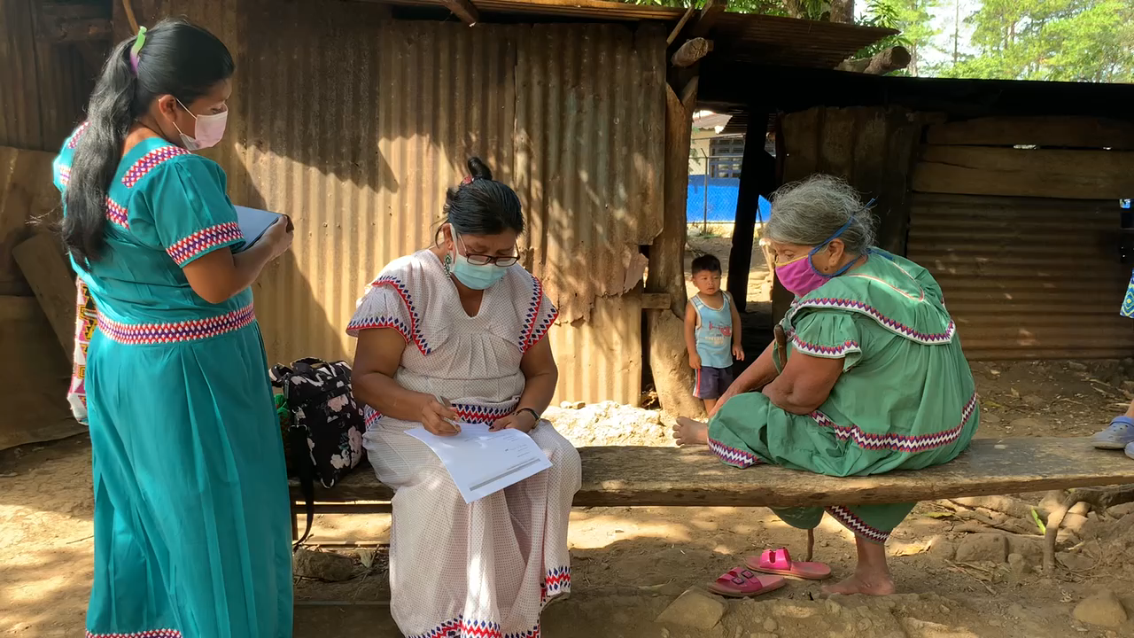
PANAMA

Slide 15
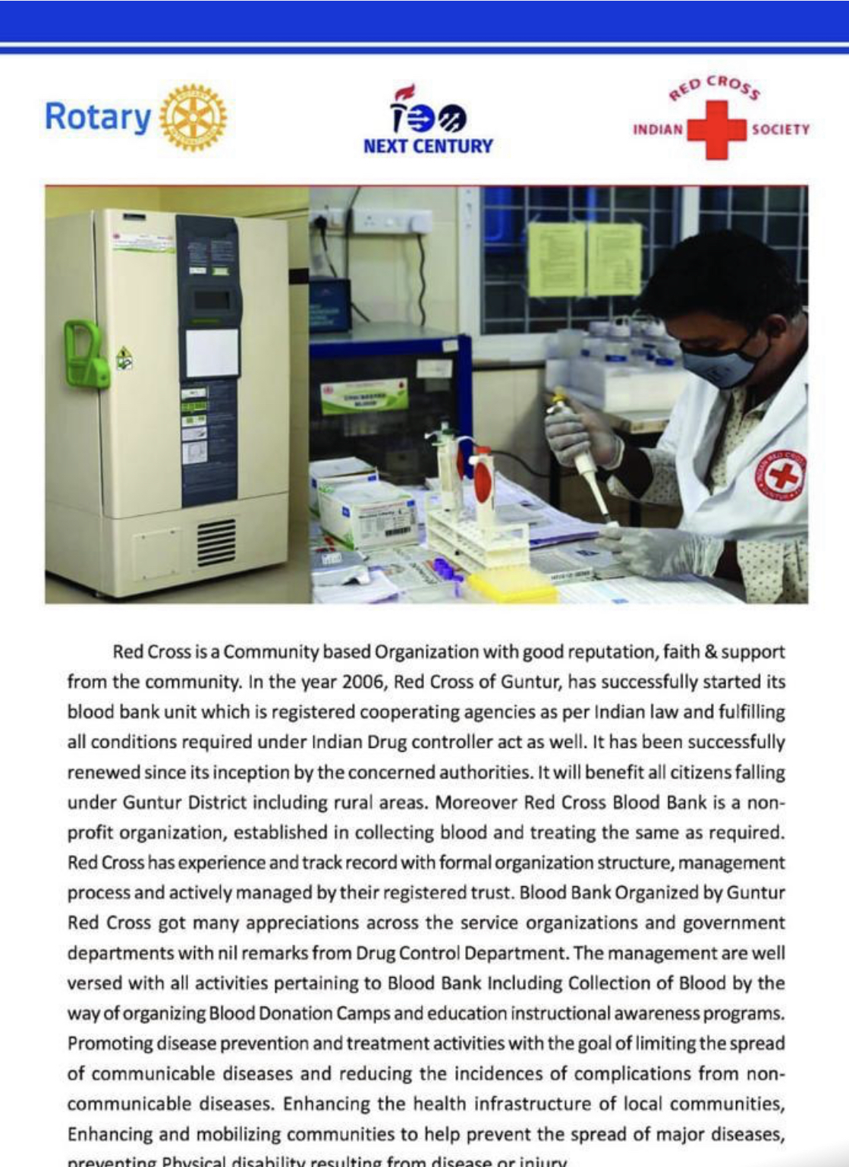
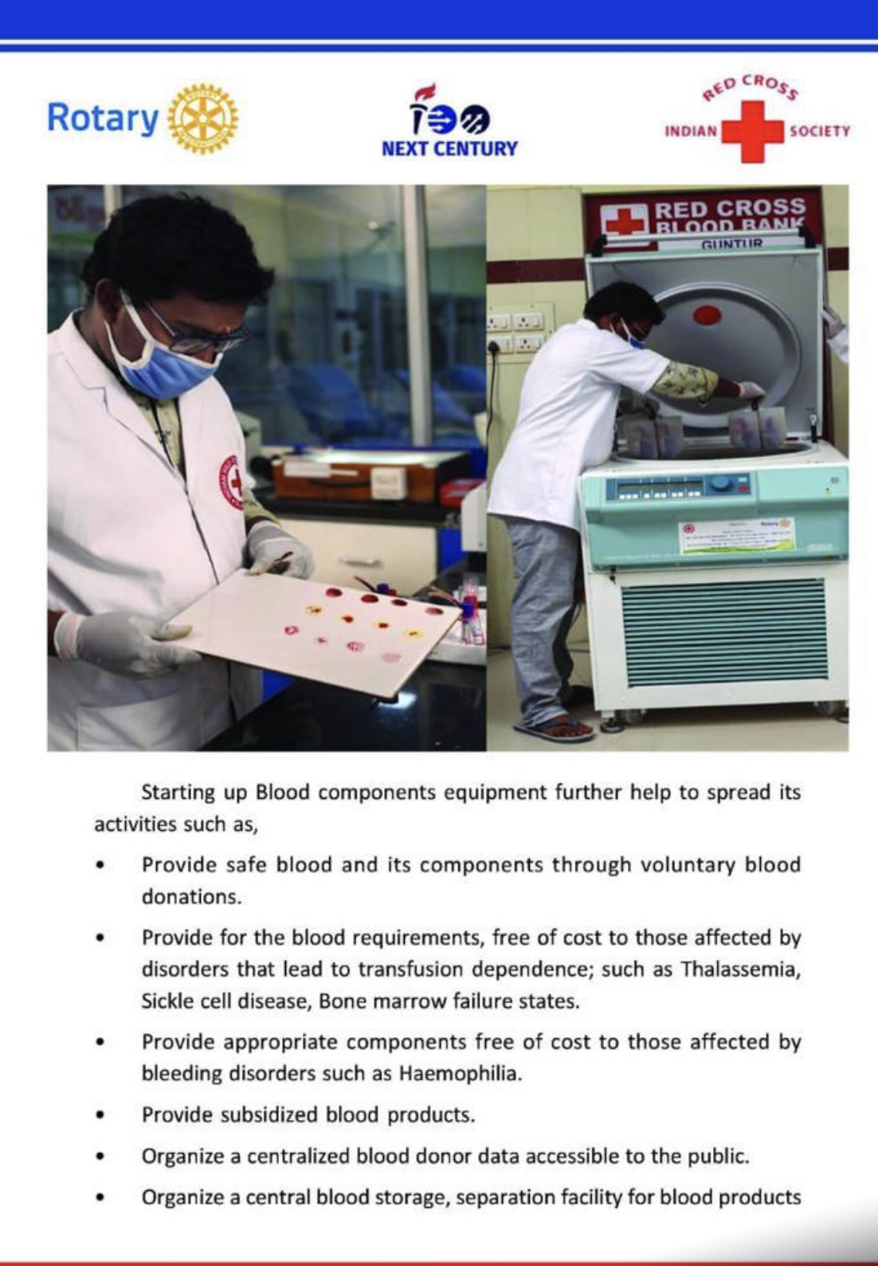
2021 GG Project in India

Slide 16
Four steps to doing Global Grant Projects
Plan and Organize
Acquire resources
Implement Project
Evaluate and Promote

Slide 17
Plan and Organize a Global Grant Project
Leverage District’s expertise in Global Grants projects
Align a project with Rotary's areas of focus
Obtain assistance with project design/planning and implementation
Learn about the global grant process
Conduct a community assessment
Identify international partners
Secure funding
Ensure the sustainability of the project
Establish measurement and evaluation benchmarks

Slide 18
Acquire Resources
Raise funds-Crowdsourcing, grants, and hold fundraisers
Promote project in Rotary Showcase, social media, club newsletter, website, and other channels.
Work with partners. Rotaract members, international partner districts or Rotary Action Groups, Rotary Community Corps, and Intercountry Committees.
Use Rotary grants from the Rotary Foundation, apply through the Grant Center

Slide 19
Implementing your project
Communicate
Communicate-Keep volunteers, stakeholders, and partners informed and up-to-date
Share
Share project news-Use social media channels and your club website
Ask
Ask questions along the way- Ask the experts your questions and share your experiences (Cadre discussions groups).

Slide 20
Evaluating and promoting
01
02
03
After completing the project, take time to reflect on its impact, its successes, and its challenges. Lessons learned.
Promote your project-to inspire others and celebrate your success with the Rotary community and the world. Remember to add photos and share the page on social media.
Submit the final report through the Grant Center.

Slide 21
Additional Project Lifecycle Resources
Project Planning Resources
Community Assessment Tools
Take the First Step to Planning Impactful Projects & Grants
Connect With Resources to Improve Projects
Guide to Global Grants
Lead Your Club: Service Projects Committee
Donations-in-kind Best Practices Guide
Rotary’s Areas of Focus guide
How to add a project to Rotary Showcase
How to join a discussion group

