Slide 1
DISTRICT 6920
DISTRICT GRANT MANAGEMENT
WELCOME!
Heather Kellen
District Governor 2022-2023
Notes:
EH: On behalf of District Governor Elect Steve Barnes, welcome to the 2020 Grant Management Seminar!

Slide 2
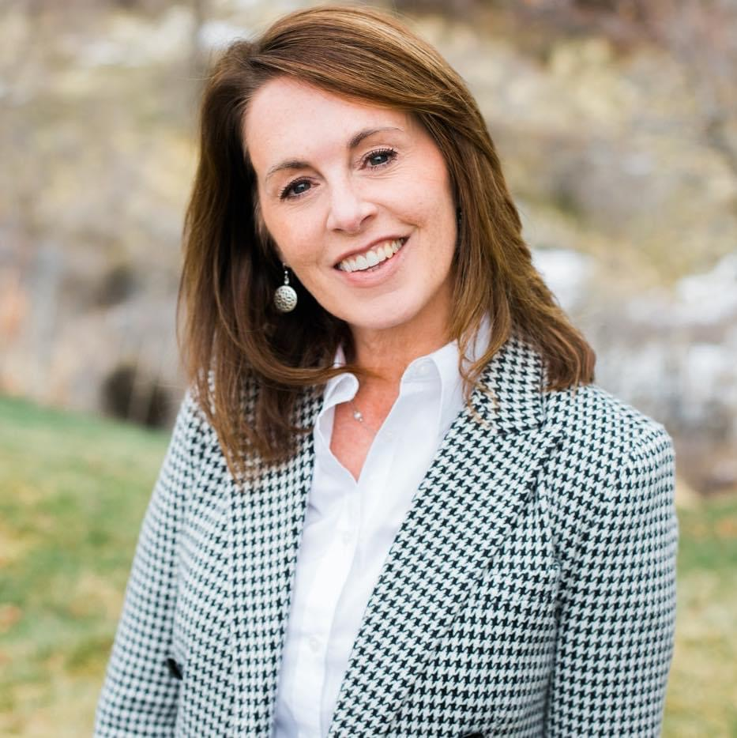
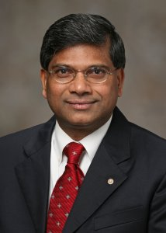
Heather Kellen District Governor 2022-23 Rotary Club of Perry
Rotary District 6920 DRFC
Foundation Chair and Global Grants Chair
Past District Governor Hamsa Thota
Notes:
EH: We appreciate you taking time to join us for the annual Grant Management Training. We are looking forward to serving with you throughout the upcoming year. Before we introduce ourselves, we’d like to know a little something about all of you.
Show of hands please, All who are ….
President Elects, Foundation chairs, District or Global Grant chairs, service project chairs, Treasurers
Who has completed a District or Global grant application or final report?
Last one… How many of you will be the one creating the District or Global Grant application this year? Great! Thanks!

Slide 3
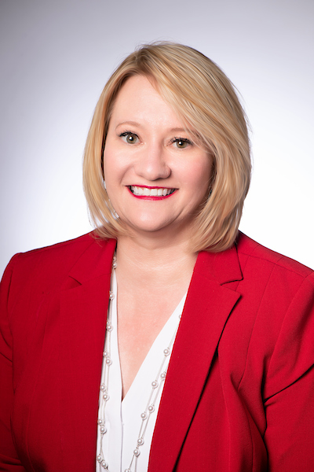
TODAY’S TRAINERS…
HUNT THORNHILL
District Grants Chair
2020-2023
JOY HURST
District Grants
Vice-Chair 2020-2023
Notes:
EH: Let me introduce today’s trainers and then we’ll cover the one and only housekeeping item. I’m Elizabeth Hardin from the Rotary Club of Downtown Macon. I’ve been in Rotary for ____ years and my favorite thing about Rotary is _________. I have the pleasure of serving as the District’s Foundation Chair. With me is Joy Hurst from the Rotary Club of Centerville. Joy is a past Asst. District Governor who serves as our District Grants Chair, bravely taking our District from paper to paperless with the new On-Line Grants Module.

Slide 4
I’M HERE!
We are taking attendance.
Please Sign In.
Thank you!
Notes:
JH: We appreciate you being here and we want to be sure your club receives credit for you attending Training. If you already signed in, thank you. If not, just raise your hand and someone will bring a Sign In sheet to you. We don’t want to miss anyone!

Slide 5
WHY ARE YOU HERE?
TOP FOUR QUESTIONS
How much is available to our club for a District Grant in 2022-23?
How can we qualify for Grant $?
Where are links & resources?
Who can we contact?
Answers today & on District Website
Notes:
JH: What do we think YOU want to get out of today’s session?

Slide 6
WHY ARE WE HERE?
Mandatory Grant Management Training
Source of our Grant Funds
Stewardship – The MOU, and Terms and Conditions (Dos and Don’ts of Managing a Grant)
Grant Reporting Requirements
Q & A
Notes:
JH: What do we think YOU want to get out of today’s session?

Slide 7
District Designated Funds (DDF) A portion of The Annual Fund comes back to our District, based on your giving 3 years prior
50%
50%
DISTRICT GRANT
(ONE BLOCK GRANT)
FOR CLUB PROJECTS
GLOBAL GRANTS

Slide 8
ROTARY FOUNDATION GRANTS
DISTRICT GRANTS
GLOBAL GRANTS
Small-scale
Short-term
Immediate Need
Support TRF Mission
$ 500 Minimum
Rotarian Involvement
Large Int’l Projects
Longer term
Sustainable
Meet 1+ of TRF’s 7 Areas of Focus
$ 30,000 Minimum
Rotarian Involvement

Slide 9
District Grant Management Training (GMT) Official Goals
Prepare clubs to implement a “Memorandum of Understanding”(MOU)
Qualify clubs to receive Rotary Foundation grant funds (Training)
Learn stewardship expectations
Understand how to successfully MANAGE a District Grant
Notes:
JH: What WE want you to get out of this session.

Slide 10
QUALIFICATION & STEWARDSHIP
What districts must do
To participate in grants, districts must complete an online qualification process in which they agree to follow and implement the financial and stewardship guidelines in the district memorandum of understanding. Each district must also conduct a grant management seminar as part of the qualification process for clubs.
What clubs must do
Clubs must complete an annual qualification process to be eligible for grants. To qualify, clubs must send one or more members to the district’s grant management seminar, sign and adhere to the club memorandum of understanding, and fulfill any additional qualification requirements set by the district.

Slide 11
Q. How did the Reimbursement Program work?
A VERY SUCCESSFUL YEAR!
A complete Final Report on use of Grant Funds now triggers release of the DDF
Qualify, Apply, Report, Get Paid
Notes:
JH: Q. HOW IS THAT WORKING OUT, YOU ASK? AWESOME! I’M SO PROUD OF YOU! Click to add A+

Slide 12
District Grant Reporting Process
Qualify and Submit Application & MOU
Clubs Receive Approval Email and Execute
District Receives Approval for Block Grant
Compile Club Projects & Submit as a Block Grant Application
File Final Report and Get Paid
Notes:
JH: Q. HOW IS THAT WORKING OUT, YOU ASK? AWESOME! I’M SO PROUD OF YOU! Click to add A+

Slide 13
We’re VERY PROUD of you!
Communities are improved and needs are met. 43 PROJECTS!
People of Action!
$55,179 in
additional Funds
You inspire others to give, serve and partner with Rotary
$120,000+ on District Projects
Rotarians doing good in the world. $72,526 in DDF

Slide 14
QUALIFICATION is SIMPLE
Sign and upload Club Memorandum of Understanding (MOU) by July 15th
At least one (1) club member attends the Grant Management Training
Not Delinquent with Reporting on District or Global Grants AND
Not Delinquent with Payment of RI / District Dues or Filing Tax Return
Notes:
JH: What WE want you to get out of this session.

Slide 15
BIG Hint …
DISTRICT AWARDS SPREADSHEET
Notes:
JH: What WE want you to get out of this session.

Slide 16
APPLY BY JUNE 30TH TO ACHIEVE 2 POINTS! LINE #29 OF AWARDS SPREADSHEET
Notes:
JH: What WE want you to get out of this session.

Slide 17
Properly Executing the MOU
Collect TWO signatures.
Upload signed MOU to the Documents tab of your application in DACdb.
YES! You may e-mail, or fax the MOU to Hunt Thornhill Hunt.Thornhill@swflant.navy.mil or Joy Hurst for assistance joycfp@windstream.net
MOU DUE: July 15th

Slide 18
All Foundation grant activities must: 1. Relate to the Foundation’s mission 2. Include active participation from Rotarians
The mission of The Rotary Foundation of Rotary International is to enable Rotarians to advance world understanding, goodwill, and peace through the improvement of health, the support of education, and the alleviation of poverty.

Slide 19
All Foundation grant activities must:
•Comply with Rotary Foundation Terms and Conditions
•Comply with Conflict of Interest Policy for Grant Participants
•Comply with Use of Rotary Marks
•Include appropriate signage or recognition of funding through The Rotary Foundation and club

Slide 20
PROJECT DEVELOPMENT CHECKLIST
•The Problem –Demonstrate the severity of the problem and the lack of other resources to address it. Use quantitative and qualitative data.
•Impact–Explain the project’s impact on the beneficiaries…how many will be impacted, how significantly, and for how long?
•Volunteer Involvement –Explain how Rotary volunteers will be involved in the project….. how many, number of hours, doing what.
•Public Image Impact –Explain how you will build community awareness of the problem and Rotary’s role in addressing it. Signage: “This project was made possible in part by a grant from the Rotary Foundation of Rotary International”

Slide 21
District Grant Project Development:
• Planning for grant project activities is encouraged, but expenses may not be incurred prior to district approval (via email).
$500 minimum total project budget. Potential partners: club or member donations, another club, community organizations

Slide 22
District Grant Project Development:
• Must not use grant funds to reimburse clubs for activities and expenses already completed or in progress before grant project approval
• After project approval, any changes to the project must be preapproved by District and TRF. MUST Cancel & resubmit for approval.

Slide 23
District Grant Project Development:
•Avoid any actual or perceived conflict of interest
•Exclude as beneficiaries any club employee, Rotarian, spouses, descendants, ancestors, or employees of partnering organizations
•Exclude as beneficiaries any former Rotarians, spouses, etc. who left Rotary less than 36 months ago
•Subject any substantial purchases from a Rotary-connected vendor to an open bid process

Slide 24
RESTRICTIONS ON GRANTS (See Handout)
Foundation funded grants may not be used for:
Purchase of land or buildings
Signage in excess of $1,000
Unrestricted donations to a beneficiary or cooperating organization (must have a receipt)
Operating expenses of another organization – NO CHECK WRITING
Support of another organization’s programs. This should be a Rotary Sponsored project!

Slide 25
TIPS TO AVOID COMMON MISTAKES
Be sure project expenditures can be done in timeframe (August –April) regardless of items out of your control –weather, dependence on other organization, etc.
Spend all the grant money in accordance with the approved project. No sharing between multiple approved projects.
Parties, gifts are not allowed unless you can show humanitarian or educational purpose.
GED and College scholarships –paid directly to the school in name of the student. May not be paid to the school’s foundation. Final report must include name of student(s) and receipt(s).

Slide 26
TIPS TO AVOID COMMON MISTAKES
No gift cards unless distribution log and receipts provided to show actual goods and services purchased
Pay the vendor or supplier of goods and/or services directly from the club’s bank account via check or debit card.
Reimbursement to individuals for project related expenses will be accepted with documentation of receipts and cancelled check as reimbursement.
Cannot be used to pay for manual labor (does not include trades such as electricians, etc.)

Slide 27
Final Report Requirements
Due within 30 days of project completion or May 15th, whichever comes first
Budget should be updated to reflect actual spending.
Upload copies of all paid invoices or receipts for each purchase with a copy of cancelled check or bank statement showing payment.
Receipts should be listed separately on Documents Tab and should correspond in order to Expenses on the Budget tab.
Upload pictures/videos to the Images tab

Slide 28
Secrets to a successful Final Report….
Budget is balanced
Confidentiality is important. Do not include Social Security numbers or birthdates.
Receipts were uploaded to show what was purchased, along with cancelled checks/bank statements to show funds were expended
Maintain records and receipts.
Keep for five years in case of audit.
The Final Report must match the project described in the Grant Application.
Club will be reimbursed up to the approved DDF amount IF PROOF OF FUNDS LEAVING CLUB’S ACCOUNT IS PROVIDED.

Slide 29
Where do we apply?
District Grants - Apply on-line at DACdb.com - Grants tab

Slide 30
What to do when you get home…
Meet with Board: Select project and partners
Enter Application on DACdb Grants Module
Collect 2 Signatures on MOU and upload to Documents tab
Call us with questions, or for assistance. Wait for approval e-mail.

Slide 31
Questions?
Resources for the future: Contact
HUNT THORNHILL
(912) 573-0542 desk
(912) 409-5748 cell
Hunt.Thornhill@swflant.navy.mil
Or
JOY HURST
(478) 971-0774
joycfp@windstream.net

